Slide 1
Lecture 6 – Developing hypotheses and testing for observed differences
Pierre Walthery - Antonia Simon
Email: p.walthery@ucl.ac.uk

Slide 2
Week 5 recap:
Making statistical inferences (1)
Sampling, the sampling distribution, the normal distribution, the Z distribution
The standard error
Confidence intervals.
(Standardising variables)
Notes:
1

Slide 3
Confidence interval: second take
We compute confidence intervals by first looking at the mean of the variable we are interested in
We can then compute its standard error
Given the central limit theorem, we can infer that there is a 95% probability that the population lie within + or -1.96 time the standard error of the mean…
… Provided a few assumptions are met
Confidence intervals can also be computed for proportions:
3

Slide 4
Inference 2
Statistical/hypothesis testing

Slide 5
Statistical testing
Confidence intervals provide a ‘shades of grey’ approach to statistical inference
Researchers have also focused on yes/no approach, trying to answer questions such as: ‘are there statistically significant differences in the population between groups’
Crucial in some applications (ie health research, engineering), not necessarily in social science
This approach is put in practice with statistical testing
5

Slide 6
1. Hypothesis testing
What is a hypothesis?
Why do we formulate hypotheses?
An example: How does age at first birth compare by education level?

Slide 7
 | Women without a degree (Group 1) | Women with a degree (Group 2)
Mean age at first birth (yrs) | 23.84 | 26.07
Standard deviation | 2.28 | 2.43
Sample size | 55 | 45

Slide 8
The null hypothesis
Because we are not able to sample all women with and without a degree in the UK, we need to be certain that the difference between these two groups of women has not simply arisen by accident.
To establish whether differences have arisen by chance, we construct a testable hypothesis known as the null hypothesis (H₀), the baseline against which we are testing the rest: ie no difference between age at first birth
‘The rest’ (aka H₁ or H_{a})is often called the alternative hypothesis. It can imply a direction (ie G1>G2) for the differences or not (ie G1<>G2). These are also called one vs two-tailed test

Slide 9
How do you write hypotheses?
First be clear in the question you are asking but ensure it is phrased like a statement, not a question!
Keep the variables in mind.
Make sure your hypothesis is "testable"
To create a "testable" hypothesis make sure you have done all of these things:
Thought about what 'experiments' you will need to carry out to do the test.
Identified the variables in the project.
Included the independent and dependent variables in the hypothesis statement. (This helps ensure that your statement is specific enough).
The most common hypotheses are about the difference between two means ie does a given mean differ between two groups; alternatively, is the mean for group A, bigger than the mean for group B?
9

Slide 10
Exercise 1: Consider these hypotheses. Which are worded well and which are poorly worded? Why?
1. When there is less oxygen in the water, rainbow trout suffer more lice.
2. Our universe is surrounded by another, larger universe, with which we can have absolutely no contact.
3. Ladybugs are a good natural pesticide for treating aphid infected plants.
4. Aphid-infected plants that are exposed to ladybugs will have fewer aphids after a week than aphid-infected plants which are left untreated.
10

Slide 11
Answers:
1. Good. It is testable, simple, written as a statement, and establishes the participants (trout), variables (oxygen in water, and numbers of lice), and predicts effect (as oxygen levels go down, the numbers of lice go up).
2. Poor. This statement may or may not be true, but it is not a scientific hypothesis. By its very nature, it is not testable. There are no observations that a scientist can make to tell whether or not the hypothesis is correct. This statement is speculation, not a hypothesis.
3. Poor. Whether or not something is a 'good natural pesticide' is too vague for a science fair project. There is no clear indication of what will be measured to evaluate the prediction.
4. Good. This hypothesis gives a clear indication of what is to be tested (the ability of ladybugs to curb an aphid infestation), is a manageable size for a single experiment, mentions the independent variable (ladybugs) and the dependent variable (number of aphids), and predicts the effect (exposure to ladybugs reduces the number of aphids).
11

Slide 12
2. Statistical tests
There are a number of statistical tests you can use to test the null hypothesis.
Which test you choose depends on the kind of variable you have – categorical, ordinal, interval-ratio.
And the distribution of the variable.
We are going to look at 2 key tests:
T Test
Chi Square

Slide 13
Whatever test you use:
We run the analysis and produce results that show a test statistic and a p value.
The p value will tell us the probability of getting a value of the test statistic equal to or greater than the one observed in your data if the null hypothesis is true.
So the smaller the value of p, the lower the probability that the null hypothesis is true (and the higher the probability that the alternative hypothesis is confirmed).
13

Slide 14
P values
Three levels of p are commonly used:
If p<=0.10 then the probability is 10% or less that the null hypothesis is true.
If p<= 0.05 then the probability is 5% or less that the null hypothesis is true.
If p<=0.01 the probability is 1% or less that the null hypothesis is true.
The closer that p gets to 0, the more statistically significant your results, and the more confident you can be in rejecting the null hypothesis.

Slide 15
P values and the hypothesis
P<0.1, 0.05, 0.01 – reject the null and accept the alternative.
P>0.1, 0.05, 0.01 – fail to reject the null and not accept the alternative.
One never accept the null – only find evidence for or against it. There can always be some data somewhere that will contradict your findings

Slide 16
Test 1: The t-test (continuous dependent variable) to compare difference in means
We have an independent variable that is categorical with only 2 outcomes: women with a degree (group 1) and without a degree (group 0), and our dependent variable is interval-ratio (age at first birth).
It assumes a normal distribution.
The t-test can be used to:
Determine whether two independent samples have different means (independent samples t-test).
(There are other t tests you can read about them in the workshop.)

Slide 17

Calculating the t statistic
The t statistics depends on the difference between group means and the variability of the groups:
Like sample estimates, test statistics have a distribution
Under the null hypothesis, how likely are we to observe this value of t or a greater one?
If the probability is small, then we can be reasonably certain that the null hypothesis can be rejected

Slide 18
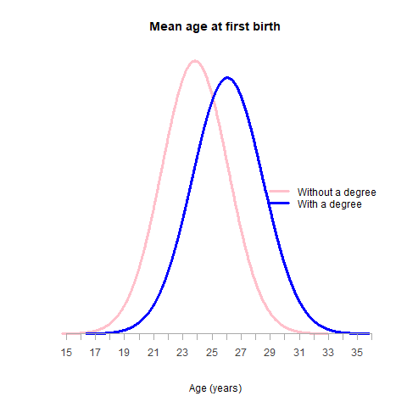
Comparing means
18

Slide 19
Stata example: men (0) and women (1): foundation stage test score (fsp)
The command in Stata:
ttest var, by (groupvar)
command
DV
group variable

Slide 20
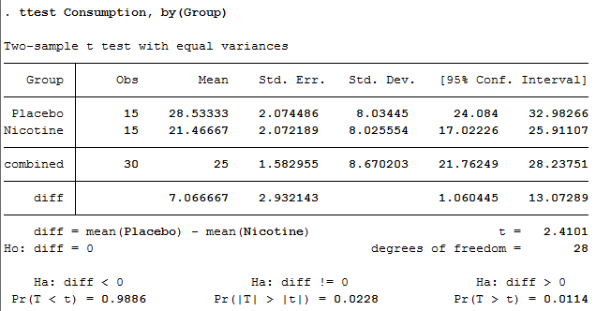
Exercise 2: What is going on here? A quit smoking campaign. Treatment group given nicotine patches; rest a placebo. Testing done after 3 months. Dep variable = nicotine consumption per day. Independent t-test.
20

Slide 21
Test 2: Chi-Square (categorical data)
Non-parametric or distribution free – ie your data do not need to be normally distributed.
Can be used with variables at any level of measurement and variables with many categories. But it can be difficult to interpret when variables have many categories.
Chi-square can be calculated from bivariate tables.

Slide 22
Bivariate tables
This is just a table which displays the scores of two different variables at the same time.
An important convention:
The dependent variable in the rows (going across the page)
The independent variable appears in the columns (going down the page).
Are individuals that belong to a religion more satisfied with their life than those who don't?

Slide 23
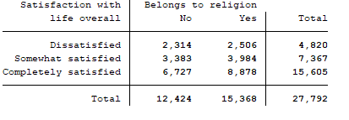
We can construct a bivariate table of participation in higher education by parental education
Command in Stata:
tabulate var1 var2
The table shows the number (‘count’ or ‘frequencies’) of observations in each combination of categories
However, since the categories are unequal in size, absolute numbers are not very meaningful, we need percentages

Slide 24
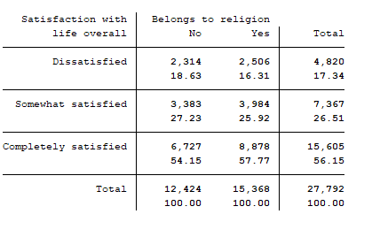
We can construct a bivariate table of participation in higher education by parental education
Command in Stata:
tabulate var1 var2, col
We need percentages that add up to 100 in each category of our independent variable.
Since our independent variable is in columns, we need column percentages

Slide 25
Interpretation
We can see that 16% of those who belong to a religion are dissatisfied with their life compared almost 19% of those who do not belong to a religion
At the same time, we see that 58 % of those who belong to a religion are completely satisfied with their life, but only 54% of those who do not belong to a religion
This gives us an impression of the association between the two variables in the sample. However, we need to formally test whether the association is statistically significant. We start with constructing the null hypothesis.
25

Slide 26
The null hypothesis
With chi square the null hypothesis states that the two variables are independent.
That is the classification into a particular category of 1 variable does not affect whether that case will fall into a particular category of the second variable.
In our example level of life satisfaction is independent of whether an individual belongs to a religion or not.

Slide 27
How chi-square works
If the null hypothesis were true (the two variables were independent) we would expect the frequencies in the table to be randomly distributed.
These would be the expected frequencies.
The observed frequencies – the ones we actually see in the table are different from the expected frequencies.
Chi-squared measures how different the observed frequencies are from the expected frequencies.
If the null hypothesis is true there should be little or no difference.

Slide 28
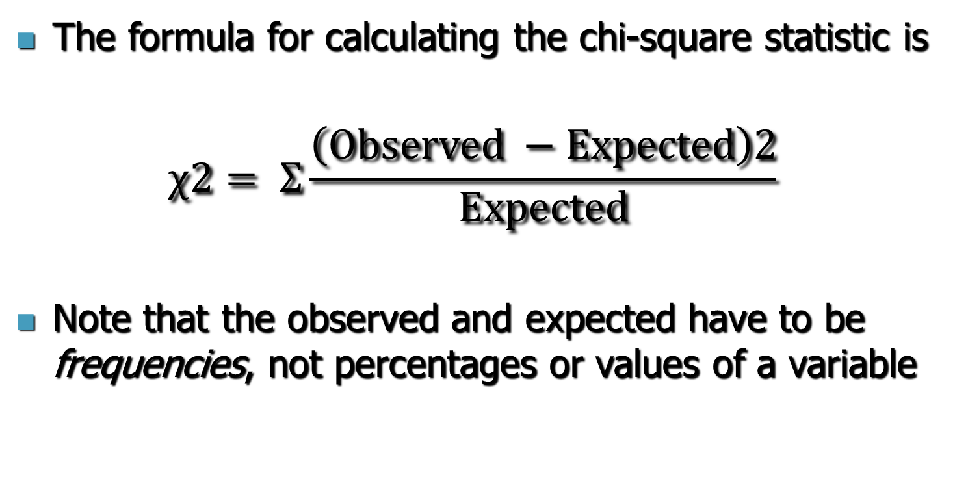
Chi-square

Slide 29
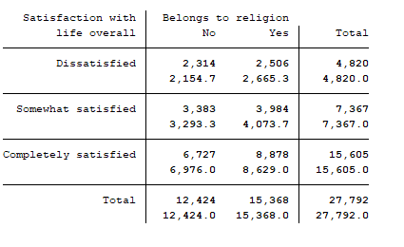
Stata can show actual versus expected frequencies
Command in Stata:
tabulate var1 var2, expected
The first number in the cell shows the observed frequencies the second number shows the expected frequencies
Using the formula shown on the last slide, we could perform the Chi-square test
But Stata does it for us…

Slide 30
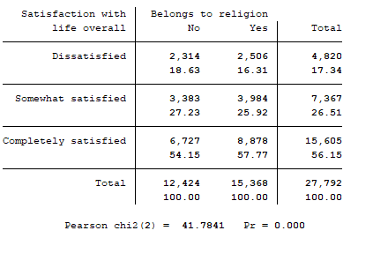
Example of chi square in stata
Command in Stata:
tabulate var1 var2, chi2
The last line of the output shows the chi squared value (41.8)
But we are mostly interested in the p-value (Pr)
Here p<0.001 – what does that mean?

Slide 31
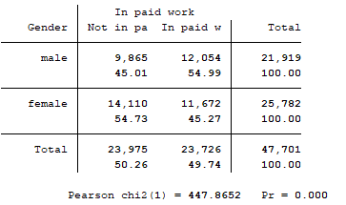
Exercise 3: What is going on here? What is it showing and is the difference statistically significant?
31

Slide 32
Any statistical testing – a recap
We construct a null hypothesis - a testable statement of no difference between groups.
We check that the data meets the assumptions for the test
Carry out the appropriate test:
T-test
Chi-square
Look at the results. If the p-value is small 0.1, 0.05 or even better 0.01 we can reject our null hypothesis.
If we reject the null, it means we can be fairly confident that any observed differences have not occurred by chance (10%, 5% or 1% depending on the above p-values).

Slide 33
A word of warning – errors in hypothesis testing
Type I error – False positive - rejecting a null hypothesis and accepting the alternative when there is no relationship. I.e. we detect a relationship and say the means are different – when they are not.
This possibility is reduced as the p-value becomes smaller. Although this increases the likelihood of:
Type II error – false negative - failing to reject a false null hypothesis. Saying the means are not different when they really are.

Slide 34
Conclusions - trade off
Decreasing the likelihood of one type of error increases the likelihood of the other.
Only way to decrease both is to increase sample size and this is not usually possible.
In the social sciences we are mostly interested in reducing type 1 errors.
This would be less of an issue if we approached inference by comparing confidence intervals, but we would not be able to make clear cut statements

Slide 35
Next week
We will look at tests of association
35

